Slide 1
Machine Learning 101
Doug Cha
©2018
http://github.com/dougfoo/machineLearning/
45min edition

Slide 2
Disclamers / Warning !
Written by a non AI/ML expert nor Data Scientist (but I’ve coded a lot of ML stuff)
Consider this content ~70% technically correct due to generalizations to simplify topics
References are added wherever possible – do your own research and form your own conclusions!
General Agenda:
What is DS, AI, ML etc ?
History and Evolution
Taxonomy of Major Types
Dive into Prediciton / Linear Regression
Extend to Logistic Regression
Neural Networks
Survey of Technology Offerings

Slide 3
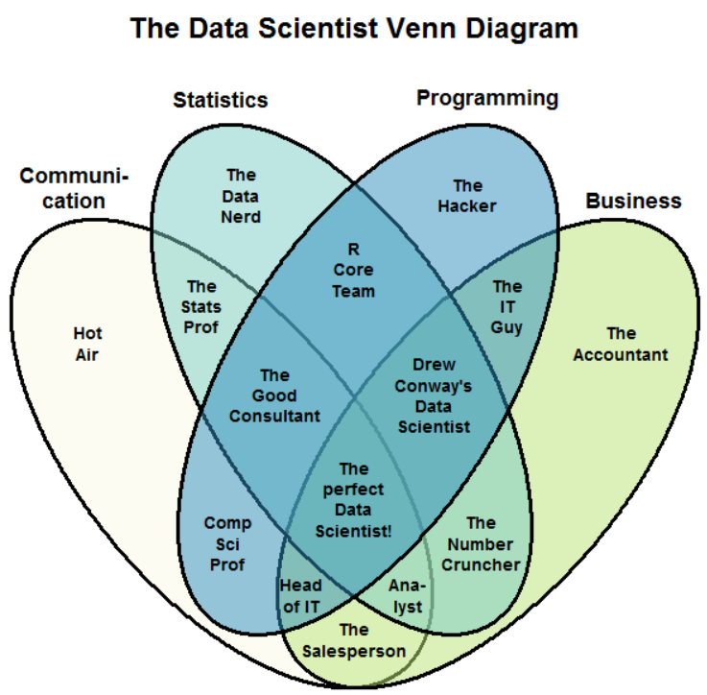
What is Data Science (aka AI/ML) ?
Data science is actually pretty old…
https://www.kdnuggets.com/2016/10/battle-data-science-venn-diagrams.html

Slide 4
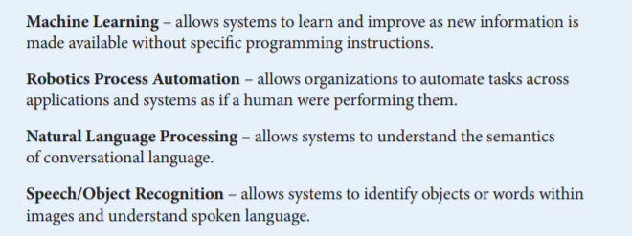
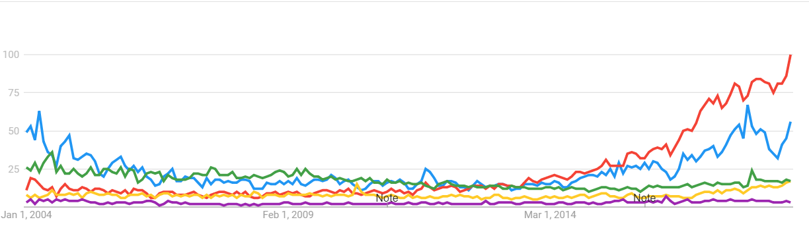
What is Artificial Intelligence ?
Google Trends 2004-Present AI vs ML vs NLP vs RPA vs Image Recognition
https://www.aba.com/Tools/Function/Technology/Documents/understanding-artificial-intelligence.pdf

Slide 5
Key Events in AI/ML History
Boom & Bust cycle 50s, 80s, 2000’s ?
Key events moved us forward:
GPU’s / Processor Power
Big Data
Research
AGI ?
Hottest Thing since Sliced Bread
Tech investment in AI (FANG, DR, H20, etc)
Minsky
Predicts AGI in 3-8yr
NN/Deep Learning on GPU
Mini Boom
“Expert Systems”
Big Data Era begins
Jeopardy / GO beaten
AI Conference
Dartmouth
GPU Invented
GPU (CUDA) for non-Gaming
Hinton “Backprop”
Dawn of Computers & NN research
IBM beats Kasparov
AI Winter
AI Winter 2
Expert Systems Bust
https://trends.google.com/trends/explore?date=all&q=machine%20learning,artificial%20intelligence
http://www.bbc.co.uk/timelines/zq376fr - “15 moments in story of AI”
http://en.wikipedia.org/wiki/History_of_artificial_intelligence
https://datafloq.com/read/big-data-history/239

Slide 6
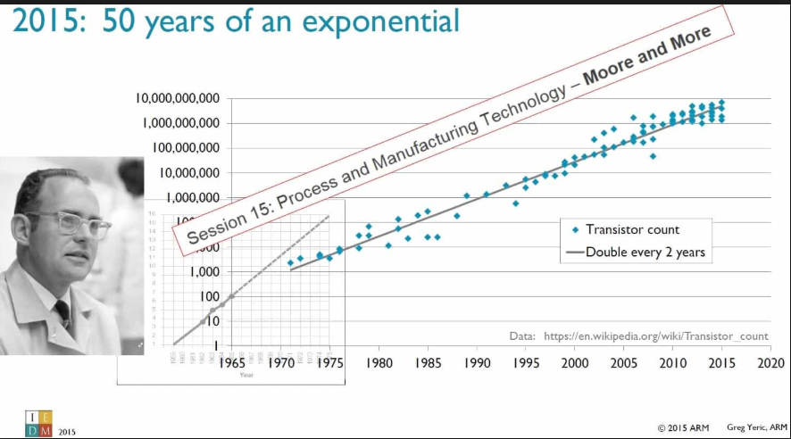
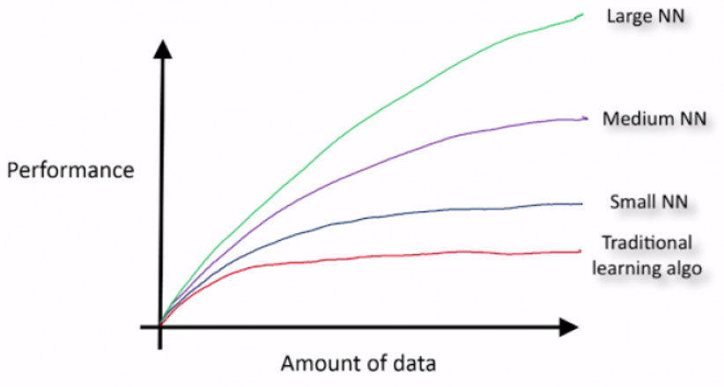
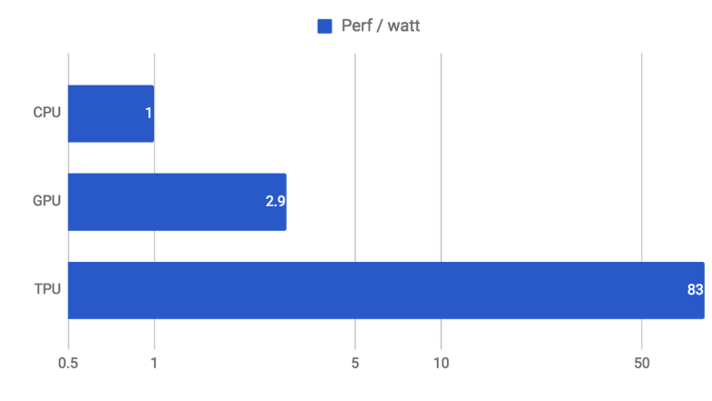
Why so Hot now ?
Research (somewhat)
Hardware Leaps (Moore’s Law + GPU/ASIC)
Big Data (unreasonable effectiveness?)
More complex models need more data
https://static.googleusercontent.com/media/research.google.com/en//pubs/archive/35179.pdf
https://cloud.google.com/blog/products/gcp/an-in-depth-look-at-googles-first-tensor-processing-unit-tpu
https://www.kdnuggets.com/2015/06/machine-learning-more-data-better-algorithms.html

Slide 7
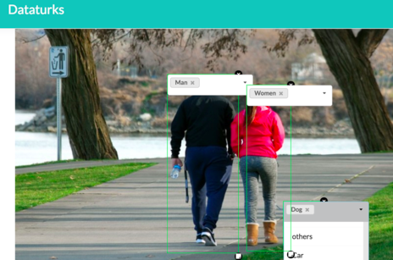
Machine Learning Taxonomy
Labelled == Supervised
Unlabelled == Unsupervised
Amazon Customer ID | Makeup Purchases | Hardware Purchases | Book Purchases
1 | $21 | $355 | $185
2 | $375 | $12 | $188
3 | $140 | $100 | $100
4 | $8500 | $7200 | $5000
5 | $7500 | $100 | $4500
Some is manually tagged
(No joke, people have to draw boxes around millions of photos... )
Tabular data example:
1
$
$$$
5
M
4
F
3
Amazon.com M/F Label ?? | Makeup Purchases | Hardware Purchases | Book Purchases
M | $21 | $355 | $185
F | $375 | $12 | $188
2

Slide 8
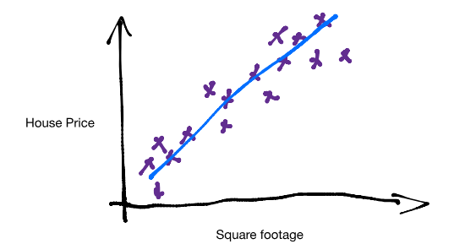
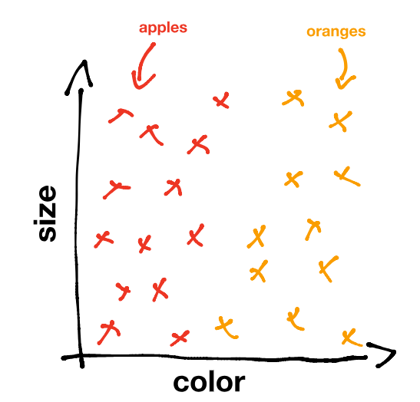
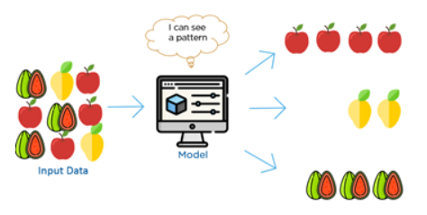
Machine Learning Applications
Prediction (a value)
Classification (predict category)
Un-Labelled / Clustering (patterns in data)
https://www.kdnuggets.com/2017/05/machine-learning-crash-course-part-1.html
https://www.youtube.com/watch?time_continue=6&v=G7fPB4OHkys

Slide 9
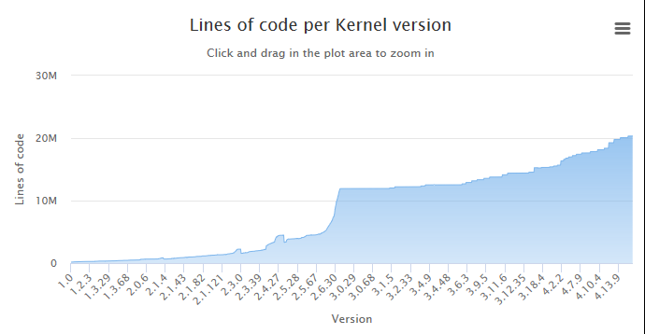
Software 1.0 (ML vs Traditional Software)
Input
Today we program Rules for a machine
But there are millions of rules (lines of code)…
Machine
Answers
Rules
Growing too complex to manage
Impossible to model Artificial General Intelligence (AGI) this way !
https://medium.com/@karpathy/software-2-0-a64152b37c35 - A.Karpathy – Tesla Director of AI
https://www.linuxcounter.net/statistics/kernel

Slide 10
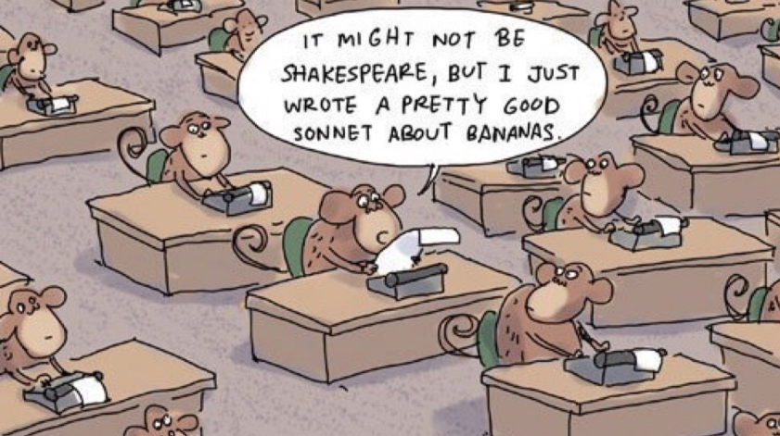
Machine Learning – Software 2.0
Given Data - the machine writes the rules ??
Given enough time, a room of monkeys can write the rules!
Input
Machine
Rules
Answers
Old Challenge:
How to manage all the lines of code.
New Challenge:
How to manage all the data.
http://en.wikipedia.org/wiki/Infinite_monkey_theorem - Infinite Monkey Theorem

Slide 11
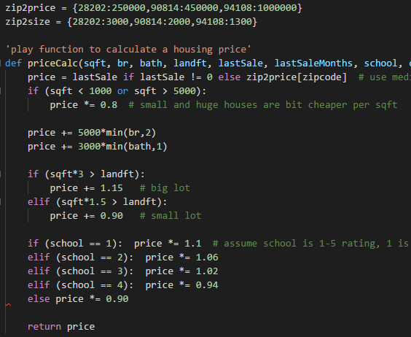
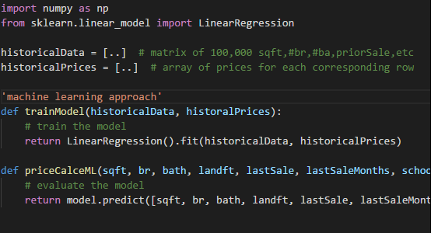
Software 1.0 vs 2.0 Example
WIP – too much text
Housing price "predictor" example:
- Inputs: sqft, br, bath, landsize, last price, last date, school rating, crime rating, inflation rate
- Output: Price Prediction !
Software 1.0: Code the rules manually (w/ all the complexity) !
Software 2.0: Pick a Model & Feed it Data
(which model .. ?) !

Slide 12
Training a Simple Linear Model - example (0)
More Simplification Needed
Example:
How to build a house price predictor?
Using inputs (features)…
X₁ – SqFt Building
X₂ – SqFt Land
X₃ – # Bedrooms
X₄ – Local School Rating
Simple “Linear” model:
p(X) = A*X₁ (SqFt Building) + B*X₂ (SqFt Land) + C*X₃ (# Bedrooms) + D*X₄ (School Rating)
Where A,B,C,D are some “weights” on each input, general form A,B,C,D = W₀₋₃
Simple linear model:
p(X) = W₀ + W₁*X₁ + W₂*X₂ + W₃*X₃ + ….
How do we set Weights?
(Remember the Monkeys writing Shakepeare? -- we can keep guessing until we find optimal one ?)
Use historical data to learn “weights” W_{o-n}
Iterate until you find the optimal set of W_{o-n}
This process is called Training the model !!!
Eventually solve the optimization problem, p(X) = 100k + 0.22*X₁ + -0.08*X₂ + 0.87*X₃ + ….

Slide 13
Training a Simple Linear Model - example (0)
WhiteBoard ?
Example:
How to build a house price predictor?
Using inputs (features)…
X₁ – SqFt Building
X₂ – SqFt Land
X₃ – # Bedrooms
X₄ – Local School Rating
Simple “Linear” model:
p(X) = A*X₁ (SqFt Building) + B*X₂ (SqFt Land) + C*X₃ (# Bedrooms) + D*X₄ (School Rating)
Where A,B,C,D are some “weights” on each input, general form A,B,C,D = W₀₋₃
Simple linear model:
p(X) = W₀ + W₁*X₁ + W₂*X₂ + W₃*X₃ + ….
How do we set Weights?
(Remember the Monkeys writing Shakepeare? -- we can keep guessing until we find optimal one ?)
Use historical data to learn “weights” W_{o-n}
Iterate until you find the optimal set of W_{o-n}
This process is called Training the model !!!
Eventually solve the optimization problem, p(X) = 100k + 0.22*X₁ + -0.08*X₂ + 0.87*X₃ + ….

Slide 14
Training a Simple Linear Model - example (0)
More Simplification Needed
Example:
How to build a house price predictor?
Using inputs (features)…
X₁ – SqFt Building
X₂ – SqFt Land
X₃ – # Bedrooms
X₄ – Local School Rating (1 best)
Simple “Linear” model:
p(X) = A*X₁ (SqFt Building) + B*X₂ (SqFt Land) + C*X₃ (# Bedrooms) + D*X₄ (School Rating)
Where A,B,C,D are some “weights” on each input, general form A,B,C,D = W₀₋₃
Simple linear model:
p(X) = W₀ + W₁*X₁ (+ W₂*X₂ + W₃*X₃ + ….)
Price | sqFtHouse | sqFtLand | Bedrooms | School
150k | 2500 | 4000 | 3 | 1
250k | 3500 | 8000 | 3 | 2
225k | 3000 | 8000 | 3 | 3
200k | 2500 | 8000 | 3 | 2
180k | 3000 | 8000 | 3 | 5
What to set W₀ and W₁ ?

Slide 15
Training a Simple Linear Model - example (0)
Maybe a diagram showing linear reg weights and how they are calibrated… or solver vs training?
Training is like calibraton

Slide 16
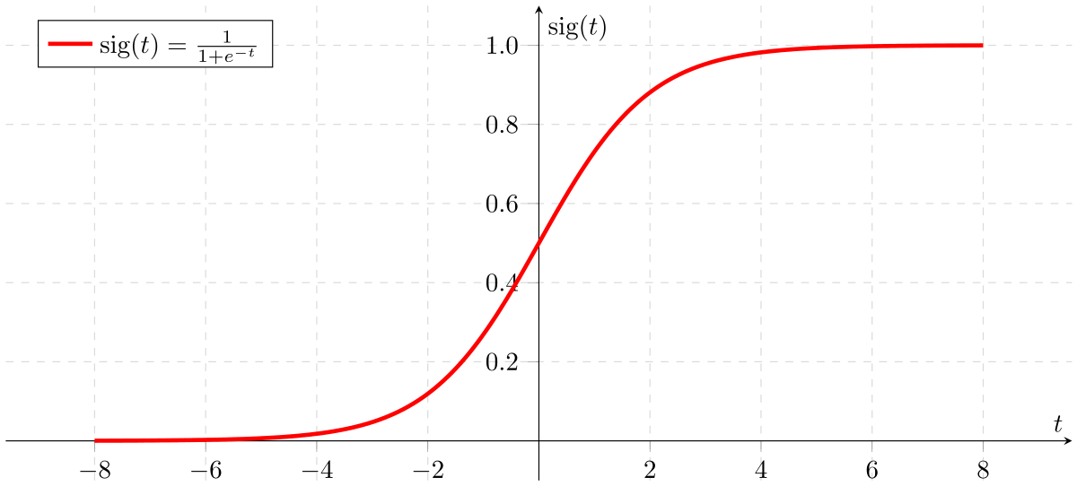
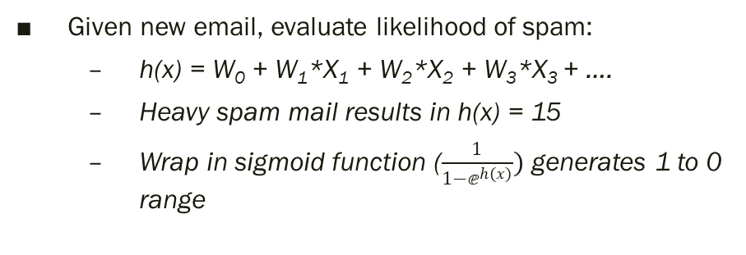
Logistic Regression – Classification
Using X_{n} - feature inputs, calculate a probability of Y or N (1 or 0)
Example E-mail Spam Detector – 4 feature “scores” generates a +/- result
X₁“Urgent”
W₁
X₂“Help”
Logistic F
Sigmoid, Relu, TanH Function
Spam?
1 or 0 (Y/N)
W₂
X₃“Audit”
W₃
W₄
X₄“Hello”
…
…
Training model sets W₁₋₄ values -1 to 1, eg:
“Urgent” – likely spam, W₁ ~ +0.9
“Help” – maybe spam, W₂ ~ +0.4
“Audit” – not likely, W₃ ~ -0.9
“Hello” – not sure, W₄ ~ +0.1
Given new email, evaluate likelihood of spam:
h(x) = W₀ + W₁*X₁ + W₂*X₂ + W₃*X₃ + ….
Heavy spam mail results in h(x) = 15
Wrap in sigmoid function ($\frac{1}{1−ⅇ^{h(x)}})$ generates 1 to 0 range
(4 features * 1,000 examples = 4,000 partial derivatives to calculate. Typical email may have ~500 words/features. Full corpus 50k)

Slide 17
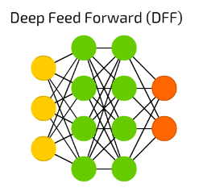
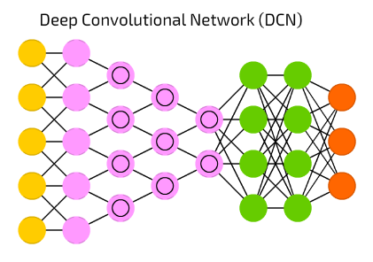
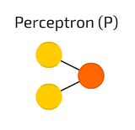
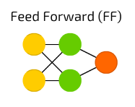
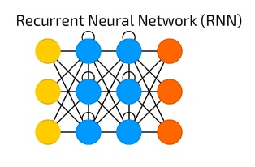
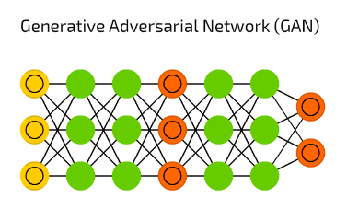
Multi-Layers = Neural Network
Looks like
Logistic Regression??
https://towardsdatascience.com/the-mostly-complete-chart-of-neural-networks-explained-3fb6f2367464

Slide 18
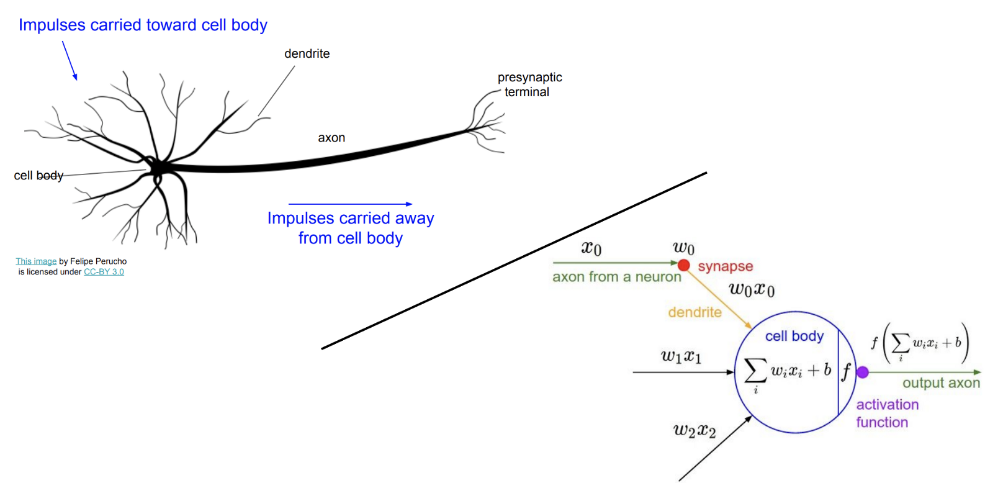
Neural Networks & the Brain
Walk thru talk better
The Computer and the Brain – John Von Neumann 1958
First concept of an Artificial Neural Network (Human Brain) was 1943 – Pitts & McCullough
Biology doesn’t really match, but it sounds great “Deep Learning” (hype)
Interesting facts:
Worm C Elegans – 300 Neurons
Fruit Fly – 135k Neurons
Human – 80B-100B Neurons
Modelling AI / ANN this way is
not going to work… !!
https://en.wikipedia.org/wiki/Artificial_neural_network
http://cs231n.stanford.edu/slides/2017/cs231n_2017_lecture4.pdf

Slide 19
Challenges to think about
Feature Growth – (Imagine 1 for every word in the dictionary ???)
Slow to train
Hard to determine valuable features vs junk
("A, And, Is, Or, …. ")
Models work best with lots of data
Where do we get all this labelled data ??
Non-Numeric Features
These models only work with #'s (output being 0-1.0)
How to encode Trade Type = “Swap, Bond, Future” into digits ?
How to normalize across numbers of various ranges (Notional $100m’s vs Gender M/F)
X₁“Urgent”
W₁
X₂“Help”
Spam?
1 or 0 (Y/N)
W₂
X₃“Audit”
W₃
W₄
X₄“Hello”
…
* 100,000 words ?

Slide 20
Challenges to think about (2)
Which model to use – there are so many ….
Dozens of clustering methods (SVM, K-Means, K-NN)
Tree algorthms (Decision Tree, Random Forests, etc)
Neural Nets (CNN, RNN, GAN, etc)
Ensemble methods (XG Boost)
More being invented every year !
Training takes time (can take days/weeks on hundreds of CPU to train an AI)
Game AI Dota2 (open.ai 2017) Months w/ 256 GPUs and 128,000 CPU cores !!
Alpha Go (Google 2015) – 40 days w/ 176 GPU
Alpha Go Zero (2017) – 3 days w/ just 4 TPU !!
https://blog.openai.com/openai-five/
https://en.wikipedia.org/wiki/AlphaGo
https://deepmind.com/blog/alphago-zero-learning-scratch/

Slide 21
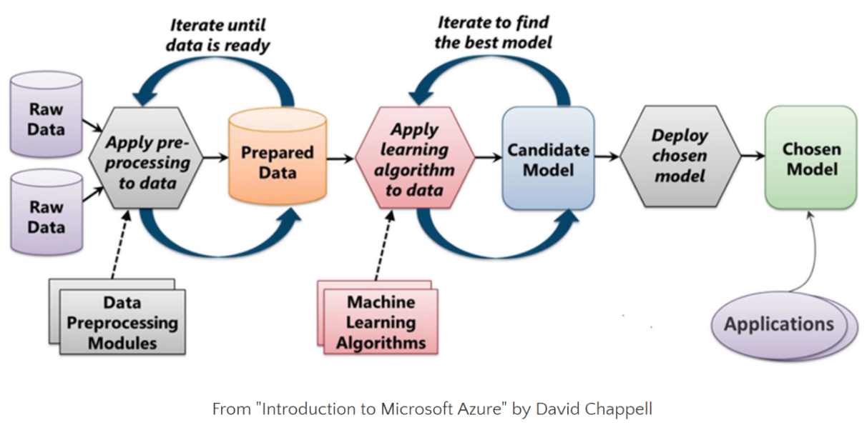
Machine Learning Process Flow
+Training
12 month project
9 months+ – 80%
2-3 months+ – 15%
Duration of phases
1-2 months+ – 5%
https://www.kaggle.com/willkoehrsen/start-here-a-gentle-introduction
https://towardsdatascience.com/microsoft-azure-machine-learning-336f83b0f27b

Slide 22
State of AI/ML – Platform Showdown
Big Data &
Database Vendors
API/Analytic Toolkits
Full Stack Vendors
Cloud Providers
Scikit Learn
TensorFlow
MXNET
PyTorch
Apache Spark & Hadoop
KDB
Oracle
Alteryx
H2o
Tableau
Google GCP
Amazon AWS
MSFT Azure
Oracle
Data Robot
Note on the danger of SkyNet & “The Singularity” (Ray Kurtzweil & Von Neumann)

Slide 23
Platform Strengths
+Training
12 month project
9 months+ – 80%
2-3 months+ – 15%
1-2 months+ – 5%
Big Data Vendors
Full Stack Vendors
Cloud Providers
Where each is strong
API Vendors

Slide 24
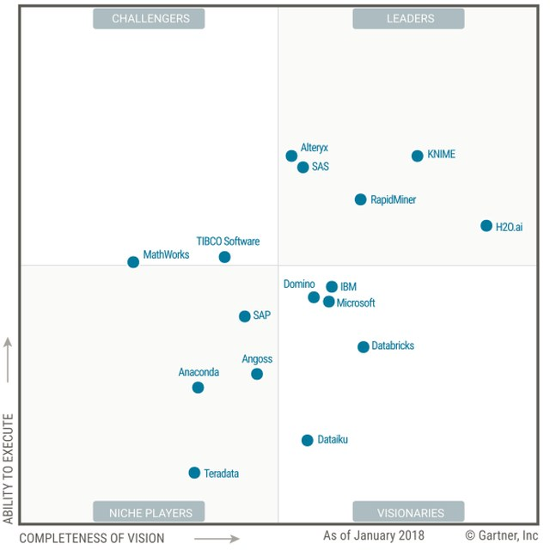
Full Stack Vendors
Summary of Gartner Magic Quadrant Analysis
“Full Stack Vendors” offer a E2E solution –
Some Data Loading ETL tools
Some Data Storage
Feature Selection Tools
Strong DS Test Env & Auto-ML
Deployment tools
Visualization/Dashboards
Where is Data Robot??
https://www.gartner.com/doc/3860063/magic-quadrant-data-science-machinelearning

Slide 25
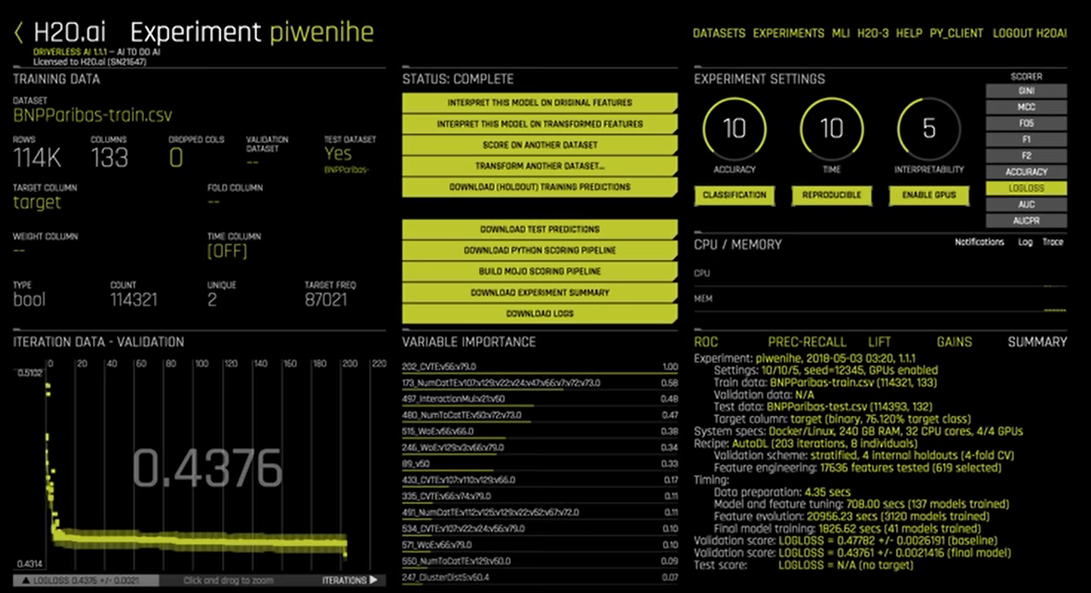
Full Stack Vendors (2)
H20 – “Driverless AI” – AutoML
Give a dataset (114k rows, 133 columns) – does all the work for you !
Auto-tune !
200 Iterations
117k features tested
3k models tested
Best results found
automatically (6hr)
https://www.gartner.com/doc/3860063/magic-quadrant-data-science-machinelearning

Slide 26
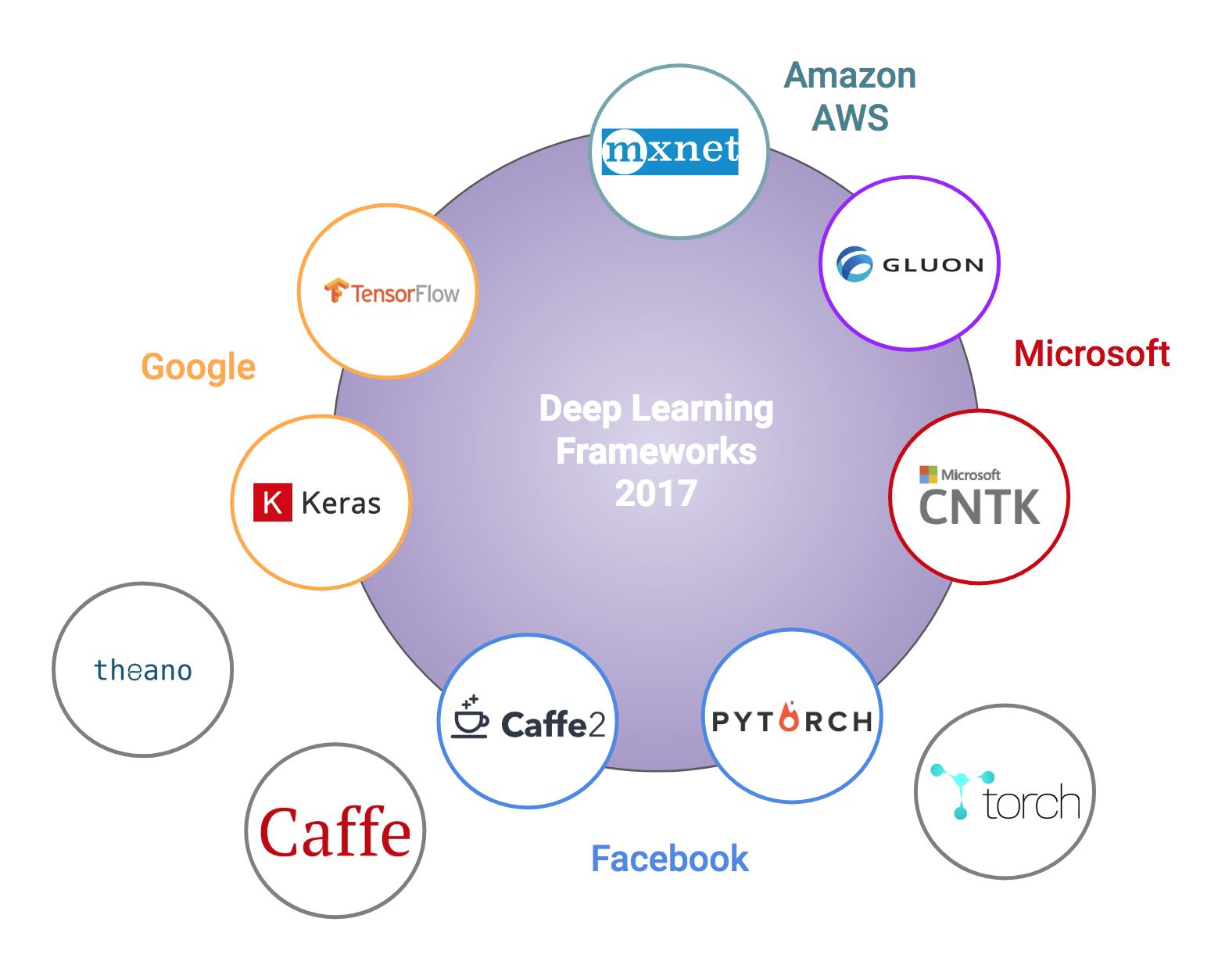
API/Analytic Toolkits
API and Analytic Libraries
Low level Libraries
All do the same thing (diff GPU/OS support)
Good for highly technical teams just needing an API library
They are all similar.. And seem to be converging (Scikit, TensorFlow, PyTorch, Keras are winning ?)..
+ScikitLearn
https://towardsdatascience.com/battle-of-the-deep-learning-frameworks-part-i-cff0e3841750

Slide 27
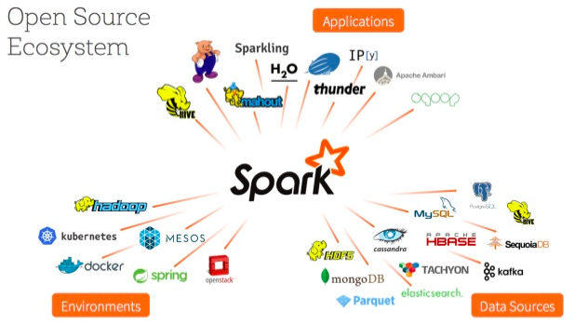
Big Data – Apache Spark/Hadoop
Apache Spark & Hadoop
KDB
Oracle
IBM
Bring ML to the data
(Data being the hardest part ?)
https://www.slideshare.net/databricks/spark-mllib-from-quick-start-to-scikitlearn

Slide 28
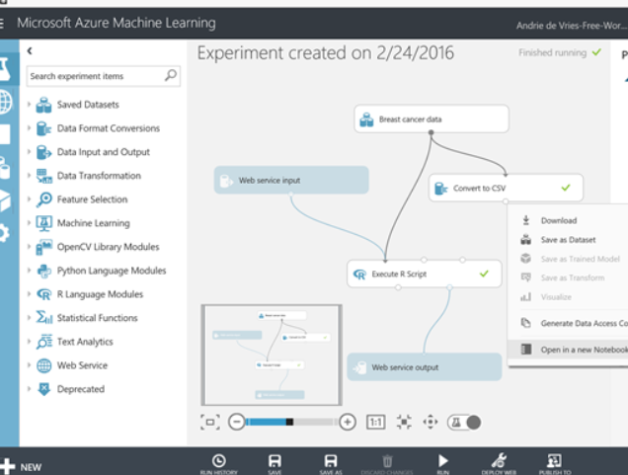
Cloud Offerings
Amazon AWS
Azure ML Studio
Google GCP & Tensorflow
Oracle Cloud Platform (GCP)
Sony Cloud
Features:
CPU/GPU/TPU on demand
Some have GUI Wizards
Good Data backend integration
Strong deployment tools

Slide 29

Final Words
“Stephen Hawking warns artificial intelligence could end mankind ...”
“Beware the singularity, says Skype founder | Stuff.co.nz”
The "Father of Artificial Intelligence" Says Singularity Is 30 Years Away ...
The Singularity..
Theory/Logic
If we can train a machine to be “smarter” than us (the creators) – “the singularity”
Then the machine can train another machine to be smarter than itself
Recursively – it can evolve into a super-intelligence
What this sometime for fun: https://www.youtube.com/watch?v=ye5C-zlCAyM&t=211s
In Practice.. we are nowhere near this for “Artificial General Intelligence” – all applications so far are “Narrow Intelligence”… Kurtzweil thought we are < 30yr away (See: AI Winter)
https://en.wikipedia.org/wiki/Technological_singularity
“Singularity” term comes from Ray Kurtzweil, who says he came up with this from reading works by John Von Neumann
https://www.technologyreview.com/s/608911/is-ai-riding-a-one-trick-pony/

Slide 30
References
History of ML
http://www.psych.utoronto.ca/users/reingold/courses/ai/cache/neural4.html
https://cs.stanford.edu/people/eroberts/courses/soco/projects/neural-networks/History/history1.html
https://www.import.io/post/history-of-deep-learning/
https://en.wikipedia.org/wik/Timeline_of_machine_learning
Singularity
Ray Kurzweil – Singularity - https://en.wikipedia.org/wiki/The_Singularity_Is_Near
John Von Neumann - https://en.wikipedia.org/wiki/The_Computer_and_the_Brain
Hardware
TPU diagram (scalar, vector, matrix) and perf chart: https://cloud.google.com/blog/big-data/2017/05/an-in-depth-look-at-googles-first-tensor-processing-unit-tpu#closeImag
Other
Kaggle – Boosting 70% wins (article: https://medium.com/syncedreview/tree-boosting-with-xgboost-why-does-xgboost-win-every-machine-learning-competition-ca8034c0b283)
Towards Data Science (Medium): https://towardsdatascience.com/
Classes:
Andrew Ng Coursera: https://www.coursera.org/courses?query=machine%20learning%20andrew%20ng
Fast Deep Learning: https://course.fast.ai/

Slide 31
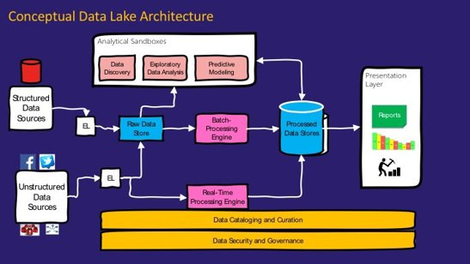
Appendix
https://medium.com/@rpradeepmenon/demystifying-data-lake-architecture-30cf4ac8aa07​
https://www.jamesserra.com/archive/2015/04/what-is-a-data-lake/

Slide 32
How it really works - Linear Regression example (1)
100’s $
Linear price model:
h(x) = W₀ + W₁*SqM + W₂*Loc + W₃*BR + …
General form:
h(x) = W₀ + W₁*X₁ + W₂*X₂ + W₃*X₃ + ….
Use X^{n} samples to learn “weights” W_{n}
10 SqM
Simplified Model example using just 1 variable/feature.
h(x) = W₀ + W₁*SqM
ie, y = mx+ b (solve for the regression line)
Solve for W₀,W₁ given x samples {5,10,15,20]; y labels=[3,4,3,5]
Algorithm:
Choose random W₀,W₁
Calculate Error (MSE - Mean Square Error)
Adjust W to minimize MSE (Gradient Descent)
Iterate until minimum error
Adapted from Andrew Ng’s Machine Learning course: https://www.coursera.org/learn/machine-learning )

Slide 33
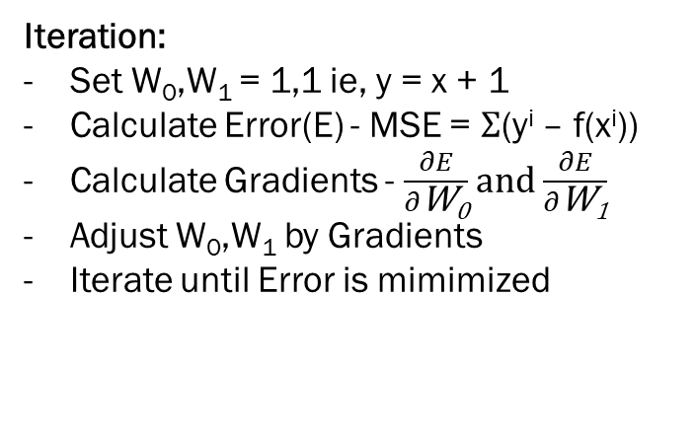
How it really works - Linear Regression example (2)
100’s $
x samples {5,10,15,20]; y labels=[3,4,3,5]
Algorithm:
Choose random W₀,W₁
Calculate Error (MSE - Mean Square Error)
Adjust W to minimize MSE (Gradient Descent)
Iterate until minimum error
10 SqM
Iteration:
Set W₀,W₁ = 1,1 ie, y = x + 1
Calculate Error(E) - MSE = $Σ$(y^{i} – f(x^{i}))
Calculate Gradients - $\frac{∂E}{∂\text{W}\text{0}}$ and $\frac{∂E}{∂\text{W}\text{1}}$
Adjust W₀,W₁ by Gradients
Iterate until Error is mimimized

